Slide 1
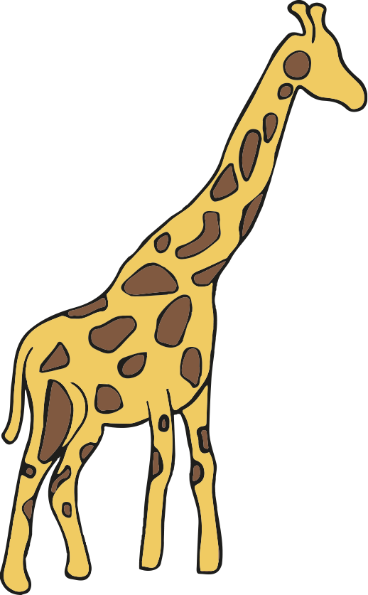




Direct proportion in context
Task A: Conversions
1) Write the following in order from the shortest to the tallest, using the conversion 1 m = 3.3 feet
Images are not to scale
5.1 m
14.2 feet
2.4 m
10.2 feet
13.2 feet
Correct order: garage, elephant, teepee, bus, giraffe
2)
Work out the maximum number of the boxes below that will fit into the box above.
a) A cube with dimensions of 40 mm b)
Images are not to scale
1.2 m
80 cm
1.6 m
0.04m
30 × 40 × 20 = 24 000 boxes
16 000
boxes
60 mm
4 cm
3) Fill in the missing values:
3.2 m² = 32 000 cm²
125 000 cm² = 12.5 m²
23 987 000 cm³ = 23.987 m³
0.74 m³ = 740 000 cm³
4) Calculate the area of this triangle. Give your answer to 2 decimal places in m².
1.09 m²
86 cm
268 cm
254 cm

Slide 2





Direct proportion in context
5) Calculate the volume of this cuboid. Give your answer in cm³.
504 000 cm³
0.7 m
1.8 m
0.4 m
Task B: Other contexts involving direct proportion
a) 23 pencils cost £14.95 How much will 34 pencils cost?
14.95 × = £22.10
b) 14 rulers cost £5.18 How much will 20 rulers cost?
5.18 × = £7.40
c) 17 sweets cost £2.55 How much will 37 sweets cost?
2.55 × = £5.55
d) 27 chocolate bars cost £11.07 How much will 39 chocolate bars cost?
11.07 × = £15.99
1)
2) Andeep is comparing prices of sunglasses in the UK, the USA and France.
Rank the following from cheapest to most expensive.
£1 : $1.28
£1 : €1.18
£48.00
$60.80
€57.23
£ | $
1 | 1.28
47.50 | 60.80
£ | €
1 | 1.18
48.50 | 57.23
In order from cheapest to most expensive: USA, UK & France.

Slide 3
Direct proportion in context
3) Calculate the ingredients needed for the following numbers of cookies.
a) 18 cookies
Butter 90 g
Sugar 150 g
Flour 150 g
Chocolate chips 120 g
Recipe for 15 cookies
75 g butter
125 g sugar
125 g flour
100 g chocolate chips
b) 72 cookies
Butter 360 g
Sugar 600 g
Flour 600 g
Chocolate chips 480 g
c) 6 cookies
Butter 30 g
Sugar 50 g
Flour 50 g
Chocolate chips 40 g
d) You have plenty of sugar, flour and chocolate chips, but only 1 kilogram of butter. What is the largest number of cookies you can make?
1 kg = 1000 g
1000 ÷ 75 = 13.333
13.3 × 15 = 200
The 13.3… represents the number of times you could make the recipe for cookies.
Since you can scale the recipe 13 and one third times you could make 200 cookies.
Alternative method for part d)
d) You have plenty of sugar, flour and chocolate chips, but only 1 kilogram of butter. What is the largest number of cookies you can make?
1 kg = 1000 g
75 ÷ 15 = 5
1000 ÷ 5 = 200
.
The 5 represents the number of grams of butter needed per cookie.
Since you have 1000 g of butter you could make 200 cookies.
Mathematics in Education and Industry
v2.3

